Slide 1


An IoT & IIoT Enterprise

Slide 2

Contents
About us
Industries Served
Lumbini Solution Architecture
Our Products
Best Practices & Features
Lumbini’s Remote Monitoring System
System Architecture for one Solar Site
System Architecture for multiple Solar Sites
Major Sensors / Devices
Solution Outline
Data format & message structure
Solar Sensors
Solar Inverter
Description & Explanation of message Structure
Solar Monitoring System & Dashboard View
Focus Industry Verticals
Our Clients & Partners
Why Lumbini Elite ?
Contact Us

Slide 3

About us
Lumbini Elite Solutions & Services Pvt. Ltd. is the leading enterprise expanding its horizons in various industry fields.
It is the one stop solution for your business with best consulting professionals successfully providing consulting, products and services that achieve the IT-objectives defined by clients.
Lumbini Elite have currently worked with the well known clients in the fields of IT software solutions, IoT & Embedded Systems.
It has proven the best set of business values for changing demographics and growing demands.
Lumbini Eilte believes in dedication towards work and always bound to time-lines for the development and delivering products and services.
The well experienced and specialized professionals feel themselves proud to provide solutions and support for our services in timely manner.
Vision
Our Focus
To become the world class IT solution provider by giving best value IT solutions
globally to our clients with quality, integrity, reliability and responsiveness
At LumbiniElite, we are focused and committed towards Products, Development & Services in the field of Cloud, Mobility & IOT
Goal
Our Key Objectives
Help our customers attain the leading edge through knowledge investments and efficient utilization of Information Technology, Provide quality services so as to enhance their productivity, profitability, reliability
Provide scalable resources capability to support the end to end delivery of IT Services to our clients
Develop and Expand the Knowledge base and solution assets through Centre of Excellences
Develop Operations (Infrastructure, Sales, IT infrastructure)

Slide 4
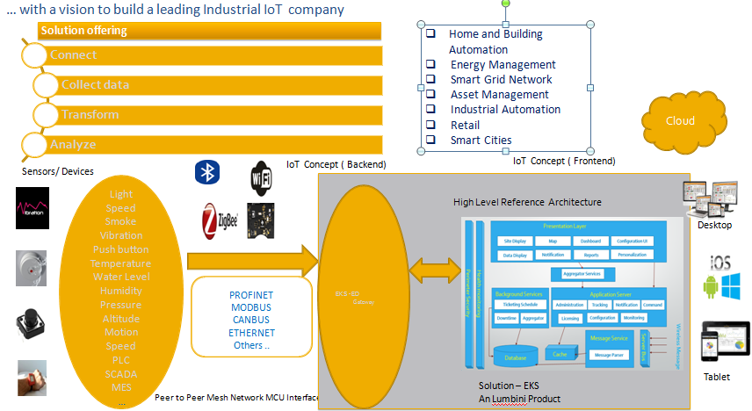
Lumbini’s Solution Architecture

Slide 5
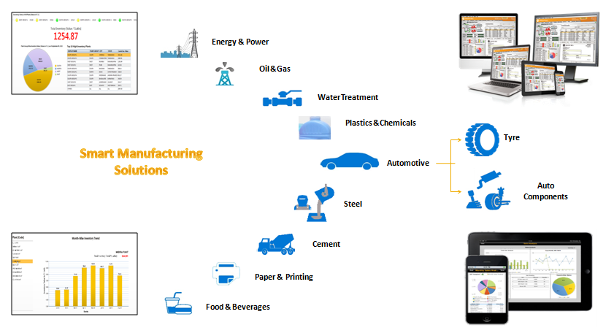
Industries Served

Slide 6
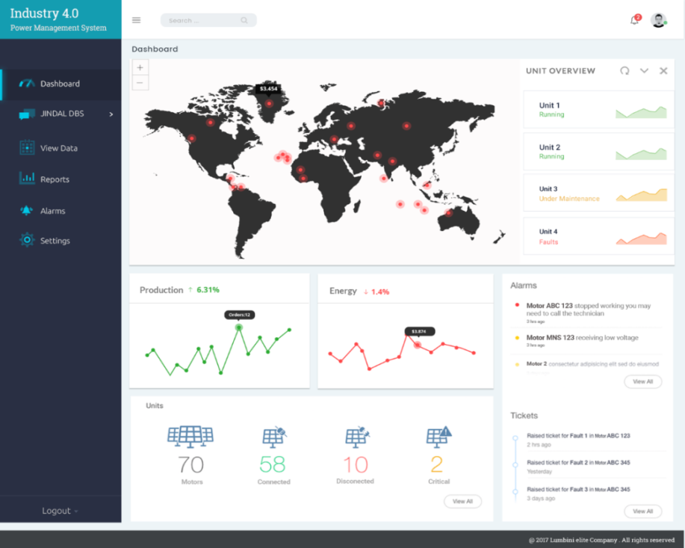
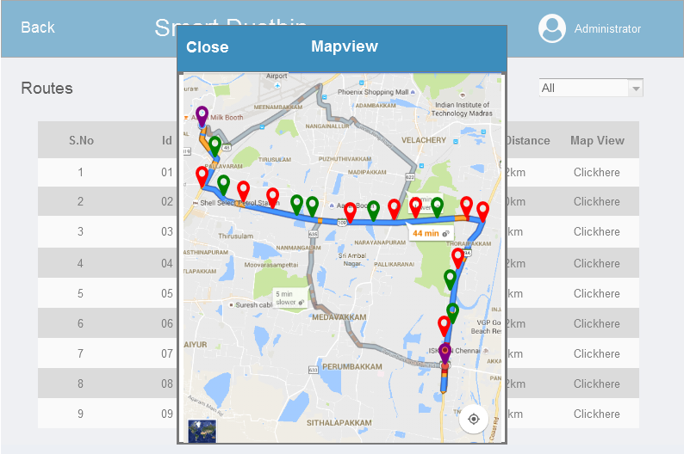
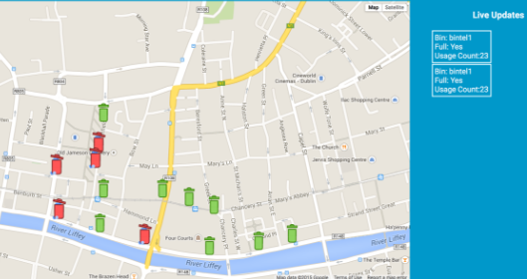
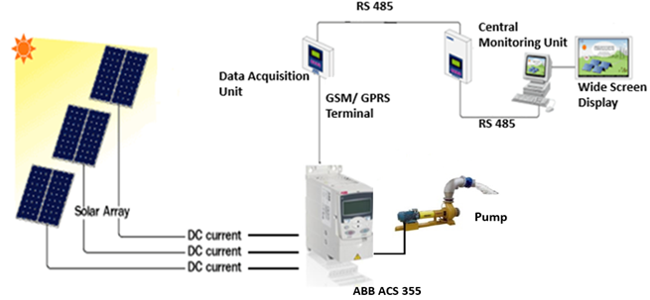
Lumbini Products
BMS
Smart Energy Monitoring Solution
AMR / AMI Smart Water Meter Remote Monitoring
Hazardous Gas Monitoring Solution
Vehicle Tracking Solution
Smart Street Light Solution
Employee and Visitor’s Tracking
Path Optimization For Forklift Trucks and Asset Tracking
Solid Waste Management Solution
AUTO - MIDAS
Agri-X
Solar – X
Wind – X
Tower - X

Slide 7
Best Practices & Features
Highlights
Install intelligent Systems/Detectors at various locations in a building
Capture important and critical parameters
Measure and gather field data through intelligent field devices and sensors etc
Process the applications through Direct Digital Controller technology
Analyse current performance and take corrective actions
Field devices:- Temperature, Humidity, Pressure sensors, Valves
Features
Precision control
Automatic operations
Safety Interlock
Energy savings
Better Maintenance Management
Man / Machine Interface
Interaction with the connected building equipment.
System Security
Alarm Management
Reporting, Data Logging, Time Scheduling
Remote connectivity

Slide 8
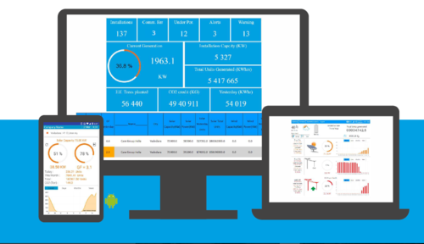
Lumbini’s Remote Monitoring System
Lumbini’s Remote Monitoring System, is entering a new era with the development of wireless sensing devices. Our deep insight on power industry and intelligent M2M Gateway capabilities help to acquires data remotely on operating conditions with cloud hosted analytics software that makes sense of disparate data points to help managers become far more proactive about managing production at peak efficiency and predictive modeling to improve return on investments.
Thus, Lumbini provides an inclusive solution for monitoring, integration, security, and solar site maintenance and management during the entire life cycle while reducing manpower and resources /costs. We serves as a unified platform that interfaces flexibly with other existing solar energy technological systems such as inverters, sensors, CCTV, ERP systems PLC's and others. Our system displays all the information gathered from the solar site and displays them on one screen in real time at a different location.

Slide 9
Introduction
The system will be able to monitor real time generation from renewable solar energy plants of heterogeneous vendors in distributed locations country-wide.
The system is capable of measuring, monitoring, recording and storing performance data of all the Solar Farms simultaneously. The data is retrieved, processed and used for analysis.
Key points are enumerated below:-
The remote monitoring application will have 3 personas which are
Super Admin: who can monitor all the sites at the same time and have control over operators
Technician: who is the operator of the control room and can monitor the site on a detailed basis
User: who is the owner of the site, can monitor the essential parameters of his site
The monitoring service shall include a complete Graphical User Interface (GUI) to represent all the monitored power generation parameters.
Real time tabular and graphical views
Viewing online data
Viewing Historical Data
Alarm Management

Slide 10






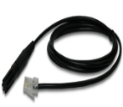
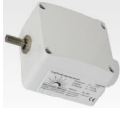


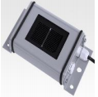
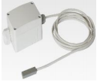
System Architecture for one Solar Site
Inverters
Remote Monitoring
Desktop
Master
Slave
Slave
Slave
Gateway
master / data logger
with in-built SIM
Database Server
RS485
RS485
RS485
Ethernet router
RS485
ETH wire
Humidity
Sensor
Ambient
Temperature
Sensor
Module
Temperature
Sensor
Wind
Direction
Sensor
Wind
Speed
Sensor
Radiation
Sensor

Slide 11

System Architecture for Multiple Solar Sites:
Web based data centre
data monitoring &
control station
SPV Plant 1
Data logger
SPV Plant 2
Data logger
INTERNET
Remote location
1
SPV Plant 3
Data logger
Web based data centre
data monitoring &
control station
SPV Plant N
Data logger
Remote web server with logging system
Remote location
2

Slide 12
Major Sensors / Devices
Irradiance Sensor
Solar irradiation sensors is for measuring solar irradiance levels, particularly for monitoring photovoltaic systems. The design of the sensor element, corresponds to the photovoltaic module, make these sensors ideally suited as a reference for monitoring photovoltaic systems.
Module Temperature Sensor
This sensor is generally used for measuring the temperature of surfaces. The module temperature can be measured by fastening the sensor to the rear of the solar module. The temperature of a solar module plays a crucial role in determining its output. Monitoring the temperature allows estimates to be made on the nature of the output curve
Ambient & Humidity Sensor
Temperature sensors measure air temperature, while humidity sensors measure air humidity. Both sensors are often applied in combination to reduce cost. This Temperature sensors should always be mounted at a height of at least 10m to ensure sufficient distance from heat radiating from the earth.
Wind speed & wind direction sensor
Both sensors come with combination, wind speed sensor measures speed of the wind lies between 0-80m/s while wind direction sensor measures the direction the wind is flowing having range between 0-360 Deg.

Slide 13
Inverter
The DC power from the solar panels is sent to an inverter, where it is converted into alternating current (AC) power, or standard electrical current used by your home. This Inverter is in-built with RS485 & RS232 for real time data transfer.
Data logger
A data logger (also data recorder) is an electronic device that records data over time or in relation to location either with a built in instrument or sensor or via external instruments and sensors.
Here, we are using a GPS based data logger having in-built SIM with RS485 / RS232 for sending the data on server.
Solution Outline
We need to place all the Solar sensors around the Solar PV panels on a given site.
And, each site is having the sensors such as irradiance, module temp., ambient & humidity, wind speed & direction and inverters integrated / connected via RS485 to the data logger (in-built SIM)
With the help of Data logger having in-built GSM device, operational and process data is monitored locally in real time and transmitted to a central location for analysis via the Internet.
Now, the Data logger send the real time data to local / cloud server through HTTP / TCP
From there we can monitor, analyze the total power generation, generate alerts, alarms, reports, etc for each sites

Slide 14
Monitoring Parameters
Sunlight radiation intensity
Module Temperature
Ambient Temperature
Humidity
Wind speed
Wind direction
Data Format & Message Structure
Solar sensor Data Format:
2018-07-04,10:05:24,7.7,8.1,28,194,29,38,41,1054, 9.3,59
Explanation:
A | B | C | D | E | F | G | H | I | J | K
2007-07-12 10:05:24 | 7.7 | 8.1 | 28 | 194 | 29 | 38 | 41 | 1054 | 9.3 | 59

Slide 15
Description:
Where,
A : This observation was made on 12 July 2018 at 10:05:24
B-D : The current wind speed, as measured at anemometer 0, was 7.7 MPH gusting to 8.1 MPH, and generating 28 pulses since the last record.
K : The wind direction was 194 degrees or 14 degrees west of south
L : The ambient temperature was 29 degrees Celsius
G: The module temperature was 38 degree Celsius
H : The humidity was 41 %
I : The radiation intensity was 1054 W/m2
J : The data logger was being supplied with 9.3 VDC
K : The checksum for the record is 59
Solar Inverter Data Format :
TCP Client sends data through Modbus
01 01 00 00 00 06 01 04 13 87 00 30
Note: The first 5 bytes are 01 01 00 00 00 and the sixth byte is the length of the data frame

Slide 16
Explanation of data sent by TCP client:
Data | Definition | Length | Note
0x01 | Device address | 1 byte | Communication address of the actual device
0x04 | Function code | 1 byte | Modbus function code to read the running information
0x13 0x87 | Start register | 2 bytes | 0x1387 = 4999, visit the data from register 4999
0x00 0x30 | Read the registers | 2 bytes | Read continually the data stored in the 48 registers.
TCP Server returns data:
01 01 00 00 00 63 02 04 60 00 27 01 2C 00 01 04 D3 E3 1E 00 01 01 3E 00 00 01 A2 01 B0 01 BA 19 64 00 70 17 84 00 80 19 69 00 70 AE 78 00 01 00 DD 00 E7 00 DA 04 B0 04 6A 04 A6 00 00 00 00 00 00 00 00 00 00 00 00 8A 9F 00 01 06 35 00 00 03 DE 01 F6 03 E6 00 00 07 DD 00 05 00 0B 00 0E 00 03 00 06 00 00 00 00 00 00

Slide 17
Explanation of data receive by TCP server:
Data | Definition | Length | Note
0x01 | Device address | 1 byte | Communication address of the actual Device
0x04 | Function code | 1 byte | Modbus function code to read the running information
0x60 | Data length | 1 byte | 96 bytes of the data behind this data Frame
0x00 0x27 | Device type code | 2 byte | Inverter SG30KTL
0x012C | Nominal Output power | 2 byte | 0x12C = 300, according to the protocol definition, it is 30.0kW
0x00 0x01 | Output type | 2 byte | According to the protocol, it is 3P4L
0x04 0xD3 | Daily power yields | 2 byte | According to the protocol, it is 123.5KWh
0xE3 0x1E 0x00 0x01 | Total power yields | 4 byte | According to the protocol, it is 123678KWh. Note that for U32 data, the sequence of byte is 2143, data needs to re-splitting to 0x0001E31E = 123678
0x01 0x3E 0x00 0x00 | Total runtime | 4 byte | According to the protocol, it is 318h. Note that for U32 data, the sequence of byte is 2143, data needs to re-splitting to 0x0000013E = 318
0x01 0xA2 | Internal temperature | 2 byte | According to the protocol, it is 41.8℃
0x01 0xB0 | Reserved | 2 byte | According to the protocol, this data is Invalid, CRC

Slide 18
Continued:
Data | Definition | Length | Note
0x01 0XBA | DC voltage1 | 2 byte | According to the protocol, this data is DC Voltage 1
0x19 0x64 | DC current 1 | 2 byte | According to the protocol, this data is DC Current 1
0x00 0x70 | DC voltage2 | 2 byte | According to the protocol, this data is DC Voltage 2
0x17 0x84 | DC current 2 | 2 byte | According to the protocol, this data is DC Current 2
0x00 0x80 | DC voltage3 | 2byte | According to the protocol, this data is DC Voltage 3
0x19 0x69 | DC current 3 | 2 byte | According to the protocol, this data is DC Current 3
0x00 0x70 0xAE 0x78 | Total DC Power | 4 byte | According to the protocol, this data is Total DC Power
0X00 0X10 | A-B Line voltage/phase A voltage | 2 byte | According to the protocol, this data is DC Voltage in A Phase
0x00 0XDD | B-C Line voltage/phase B voltage | 2 byte | According to the protocol, this data is DC Voltage in B Phase
0X00 0XE7 | C-A Line voltage/phase C voltage | 2 byte | According to the protocol, this data is DC Voltage in C Phase
0X00 0XDA | Phase A Current | 2 byte | According to the protocol, this data is DC Current in A Phase

Slide 19
Continued:
Data | Definition | Length | Note
0x04 0xB0 | Phase B Current | 2 byte | According to the protocol, this data is DC Current in B Phase
0x04 0x6A | Phase C Current | 2 byte | According to the protocol, this data is DC Current in C Phase
0x04 0x A6 0x00 0x 00 | Reserved | 4 byte | According to the protocol, this data is invalid
0x00 0x 00 0x00 0x 00 | Reserved | 4 byte | According to the protocol, this data is invalid
0x00 0x 00 0x00 0x 00 | Reserved | 4byte | According to the protocol, this data is invalid
0x00 0x 00 0x8A 0x 9F | Total Active Power | 4 byte | According to the protocol, this data is Total Active Power
0x00 0x 01 0x06 0x35 | Total Reactive Power | 4 byte | According to the protocol, this data is Total Reactive Power
0x00 0x00 | Power Factor | 2 byte | According to the protocol, this data is Power Factor
0x03 0xDE | Grid Frequency | 2 byte | According to the protocol, this data is Frequency
0x01 0xF6 | Reserved | 2 byte | According to the protocol, this data is invalid
0x03 0XE6 | Nominal Reactive power | 2 byte | According to the protocol, this data is Nominal Reactive Power

Slide 20
Continued:
Data | Definition | Length | Note
0x00 0x 00 0x07 0xDD | Reserved | 4 byte | According to the protocol, this data is invalid
0x00 0x05 | Impedance to the ground in parallel connection | 2 byte | According to the protocol, this data is Impedance
0x00 0x0B | Reserved | 2 byte | According to the protocol, this data is invalid
0x00 0x0E | Daily running time | 2 byte | According to the protocol, this data is Daily running time i.e.14
0x00 0x03 | Present country | 2 byte | According to the protocol, this data is Country name
0x00 0x06 | DC Voltage 4 | 2 byte | According to the protocol, this data is DC Voltage 4
0x00 0x00 | DC Current 4 | 2 byte | According to the protocol, this data is DC Current 4
0x00 0x00 0x00 0x00 | Reserved | 4 byte | According to the protocol, this data is invalid

Slide 21
Highlights
Customizable firmware based on project requirements
Communication of data to server on specific events on configured intervals
Storing and forwarding of data in case of communication failures
Supports protocol like HTTP, TCP/IP, UDP or FTP for data communication to the server
Supports MQTT protocol for communication with MQTT broker/server
Provision for implementing protocol like Modbus, DLMS, or any other protocol and acquire data from one or more devices connected to RS232 or RS485 ports.
Facility to store mobile numbers in different groups for authorization and SMS alerts.
Facility to go on low power mode when there is no communication and automatic wake up on incoming communication and serial events
Watchdog timer & Over the air updating of firmware
Features
RS 232 and /or RS 485 ports for data acquisition
Supports protocol like HTTP, TCP/IP, UDP or FTP for data communication to the server
Supports MQQT protocol
Customizable firmware
Built in RTC
Low cost
9-24v DC input power
Sleep mode for low power consumption
Operating temperature: -40 -- +85 degree Celsius
Sensitivity: -109dBm ( 850/ 900 MHz), -108dBm ( 1800/ 1900 MHz),

Slide 22
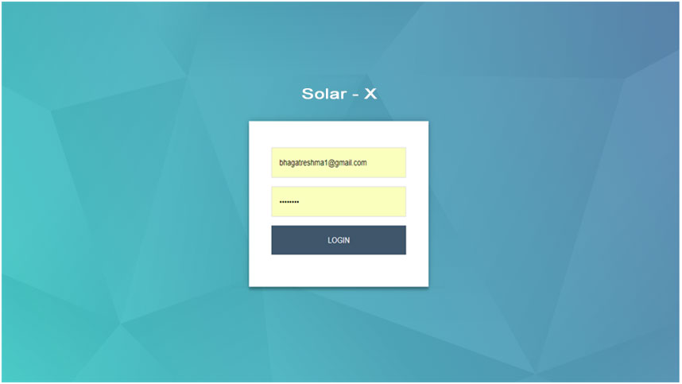
Monitoring Solution & Dashboard View:
The remote monitoring application will have 3 personas which are:
Super Admin
Technician
Customer
Login Screen

Slide 23
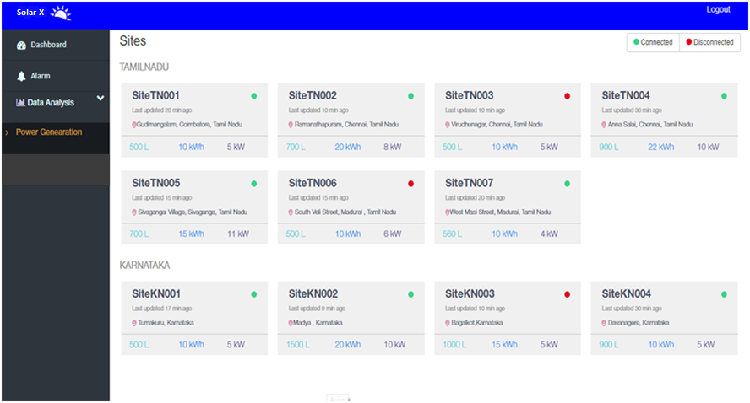
Super Admin
The Super Admin is the person who can remotely monitor all the sites in a single go. He is the one who has control over the operators. The monitoring services renders all the essential parameters in a graphical user interface (GUI) where he can inspect all the real time data on a graphical format.
Total Sites

Slide 24
Operator
The Operator is the person who can remotely monitor all the sites in a detailed format ( site wise)
Ubiquitous visibility of real-time pump data over Mobile & Cloud based Application
Analyzes and compares the massive volume of data between two sites.
Predictive tools and customized alerts to schedule maintenance of connected System, which replaces the need for ongoing inspections
Real time tabular and graphical views
Viewing online data
Viewing Historical Data
Alarm Management
View Reports
Features
There is also the facility to view the tabular and graphical data of the various parameters
Zooming option for graphs
Real time Interactive graphs
Duration of the graph data can be selected

Slide 25
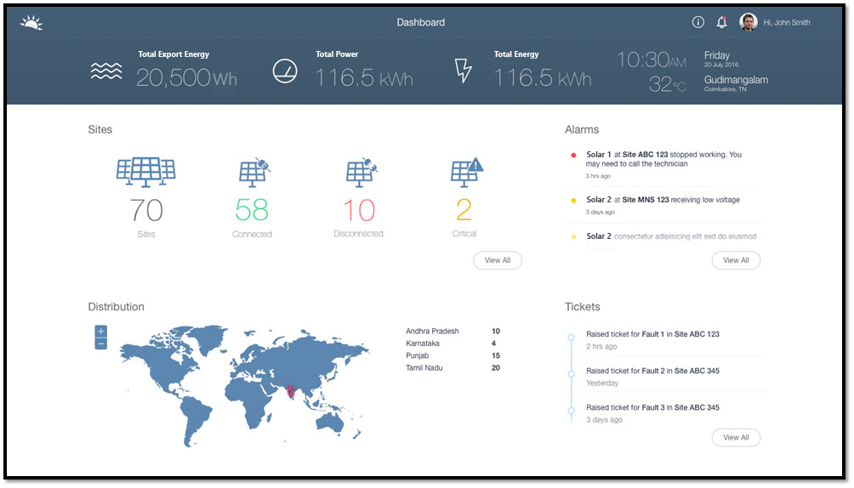
Dashboard Screen for Operators

Slide 26
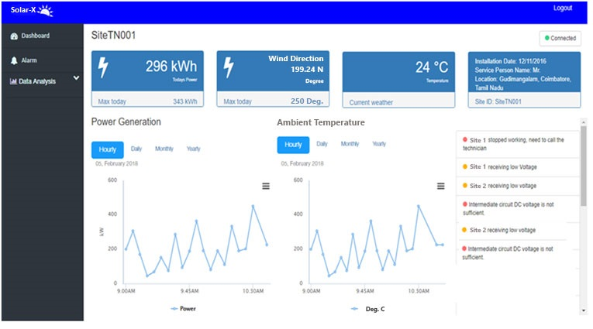
Each Site Info:
The Technician as well as admin will able to monitor each site’s which includes:
Whether the site is connected or disconnected
Power generation
Radiation intensity
Ambient temperature

Slide 27
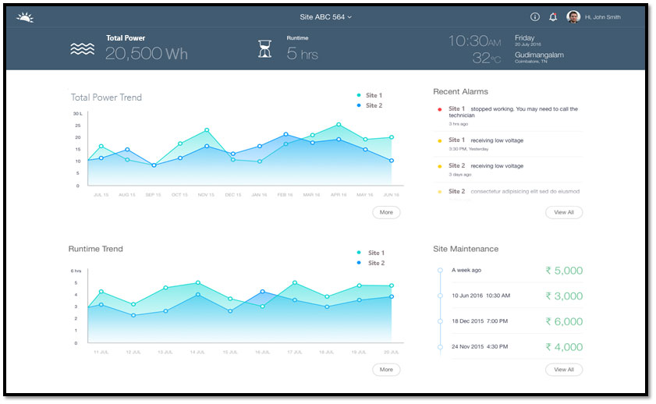
Customer
Owner of the site
Views the essential parameters such as water flow, power generation, run hour.
Real time tabular and graphical views
Can request for service of the site
Gets notification/ alarms form the operator regarding his site.

Slide 28
Features of the Remote Monitoring Solution
Ubiquitous visibility of real-time pump data over Mobile & Cloud based Application
Centralized Application to remotely monitor the pumps distributed across geographies
Transparent Visibility for Operators to manage and analyze massive volumes of collected data
Interactive dashboards with customized widgets facilitating world class UI/UX experience.
Predictive tools and customized alerts for operators to schedule maintenance of connected System, by replacing the need for ongoing inspections.
SMS/ Email/ Dashboard/ Mobile App Alerts/ Events
Provision for Data export in various Formats like, Excel, PDF, Text, CSV
Unlimited Historical data made available for report generation
Admin Tool for Self-management of all Pumps/ OEM’s/ Customers
Advantages
Monitor and control
Reduce service calls and downtime
Maintain customer connection
Staying connected with green lifestyle

Slide 29







Focus Industry Verticals
Utilities
Renewable Energy
E-Governance
AFS
Pharmaceuticals
Manufacturing
Consumer Goods and Retail

Slide 30

Our Clients & Partners

Slide 31

Why Lumbini Elite ?
An IT Company with experiences and expertise in new Dimension areas like Analytics, Mobility, Cloud and IOT .
Based in Bangalore, (Whitefield), IT hub of India with presence in Jharkhand ( Ranchi ) & Tamil Naidu ( Chennai & Coimbatore )
An ISO-9001 2015 / ISO-14001 - 2015 certified company.
Founder and Senior resources have experiences working for IT product and service companies like SAP, Philips, TCS, WIPRO
Strong association with German Software Product companies - SAP
Feedback & Exploration Partner
SAP Startup Focus Member
COIL ( Co-innovation Lab) Partner
Associated with Microsoft as Microsoft Bizspark Member
Offering IT Services to various IT majors like Accenture, Softtek, L&T, ITC, Bristlecone, NTTDATA to name few.
Engaging end clients like Transferet, Lichchhwi Foods, Elitia Inc, JREDA etc

Slide 32

Contact Us
Corporate Office
#7, SJR Eternity, Phase – 1,
Kodigehalli Road, Hoodi,
Bangalore – 560048 ( Karnataka )
Registered Address
C.D. – 361, Sector – 3,
Post – Dhurwa , Dist - Ranchi,
PIN – 834004 , Jharkhand
For Further details please contact:
Ph. No. - +91 80 4203 7777
Email:- info@lumbinielite.com
Or visit our website
www.lumbinielite.com
THANK YOU

